Slide 1


183 DB Weekly Report
Week 6 Team Parsley
Lin Li, Amir Omidfar, Wilson Chang, Angel Jimenez

Slide 2
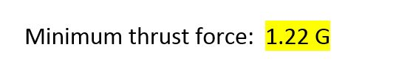

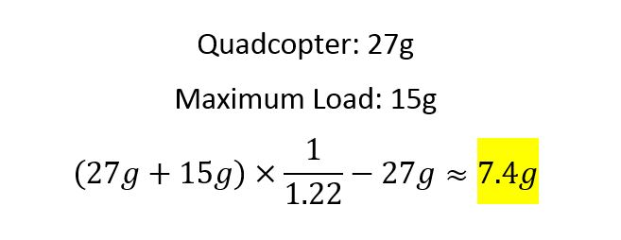
Controller Model
Controller Implementation Challenge:
How to connect the controller motor with the quadcopter?
Obtained data from the simulation
Actual available load for the controller

Slide 3
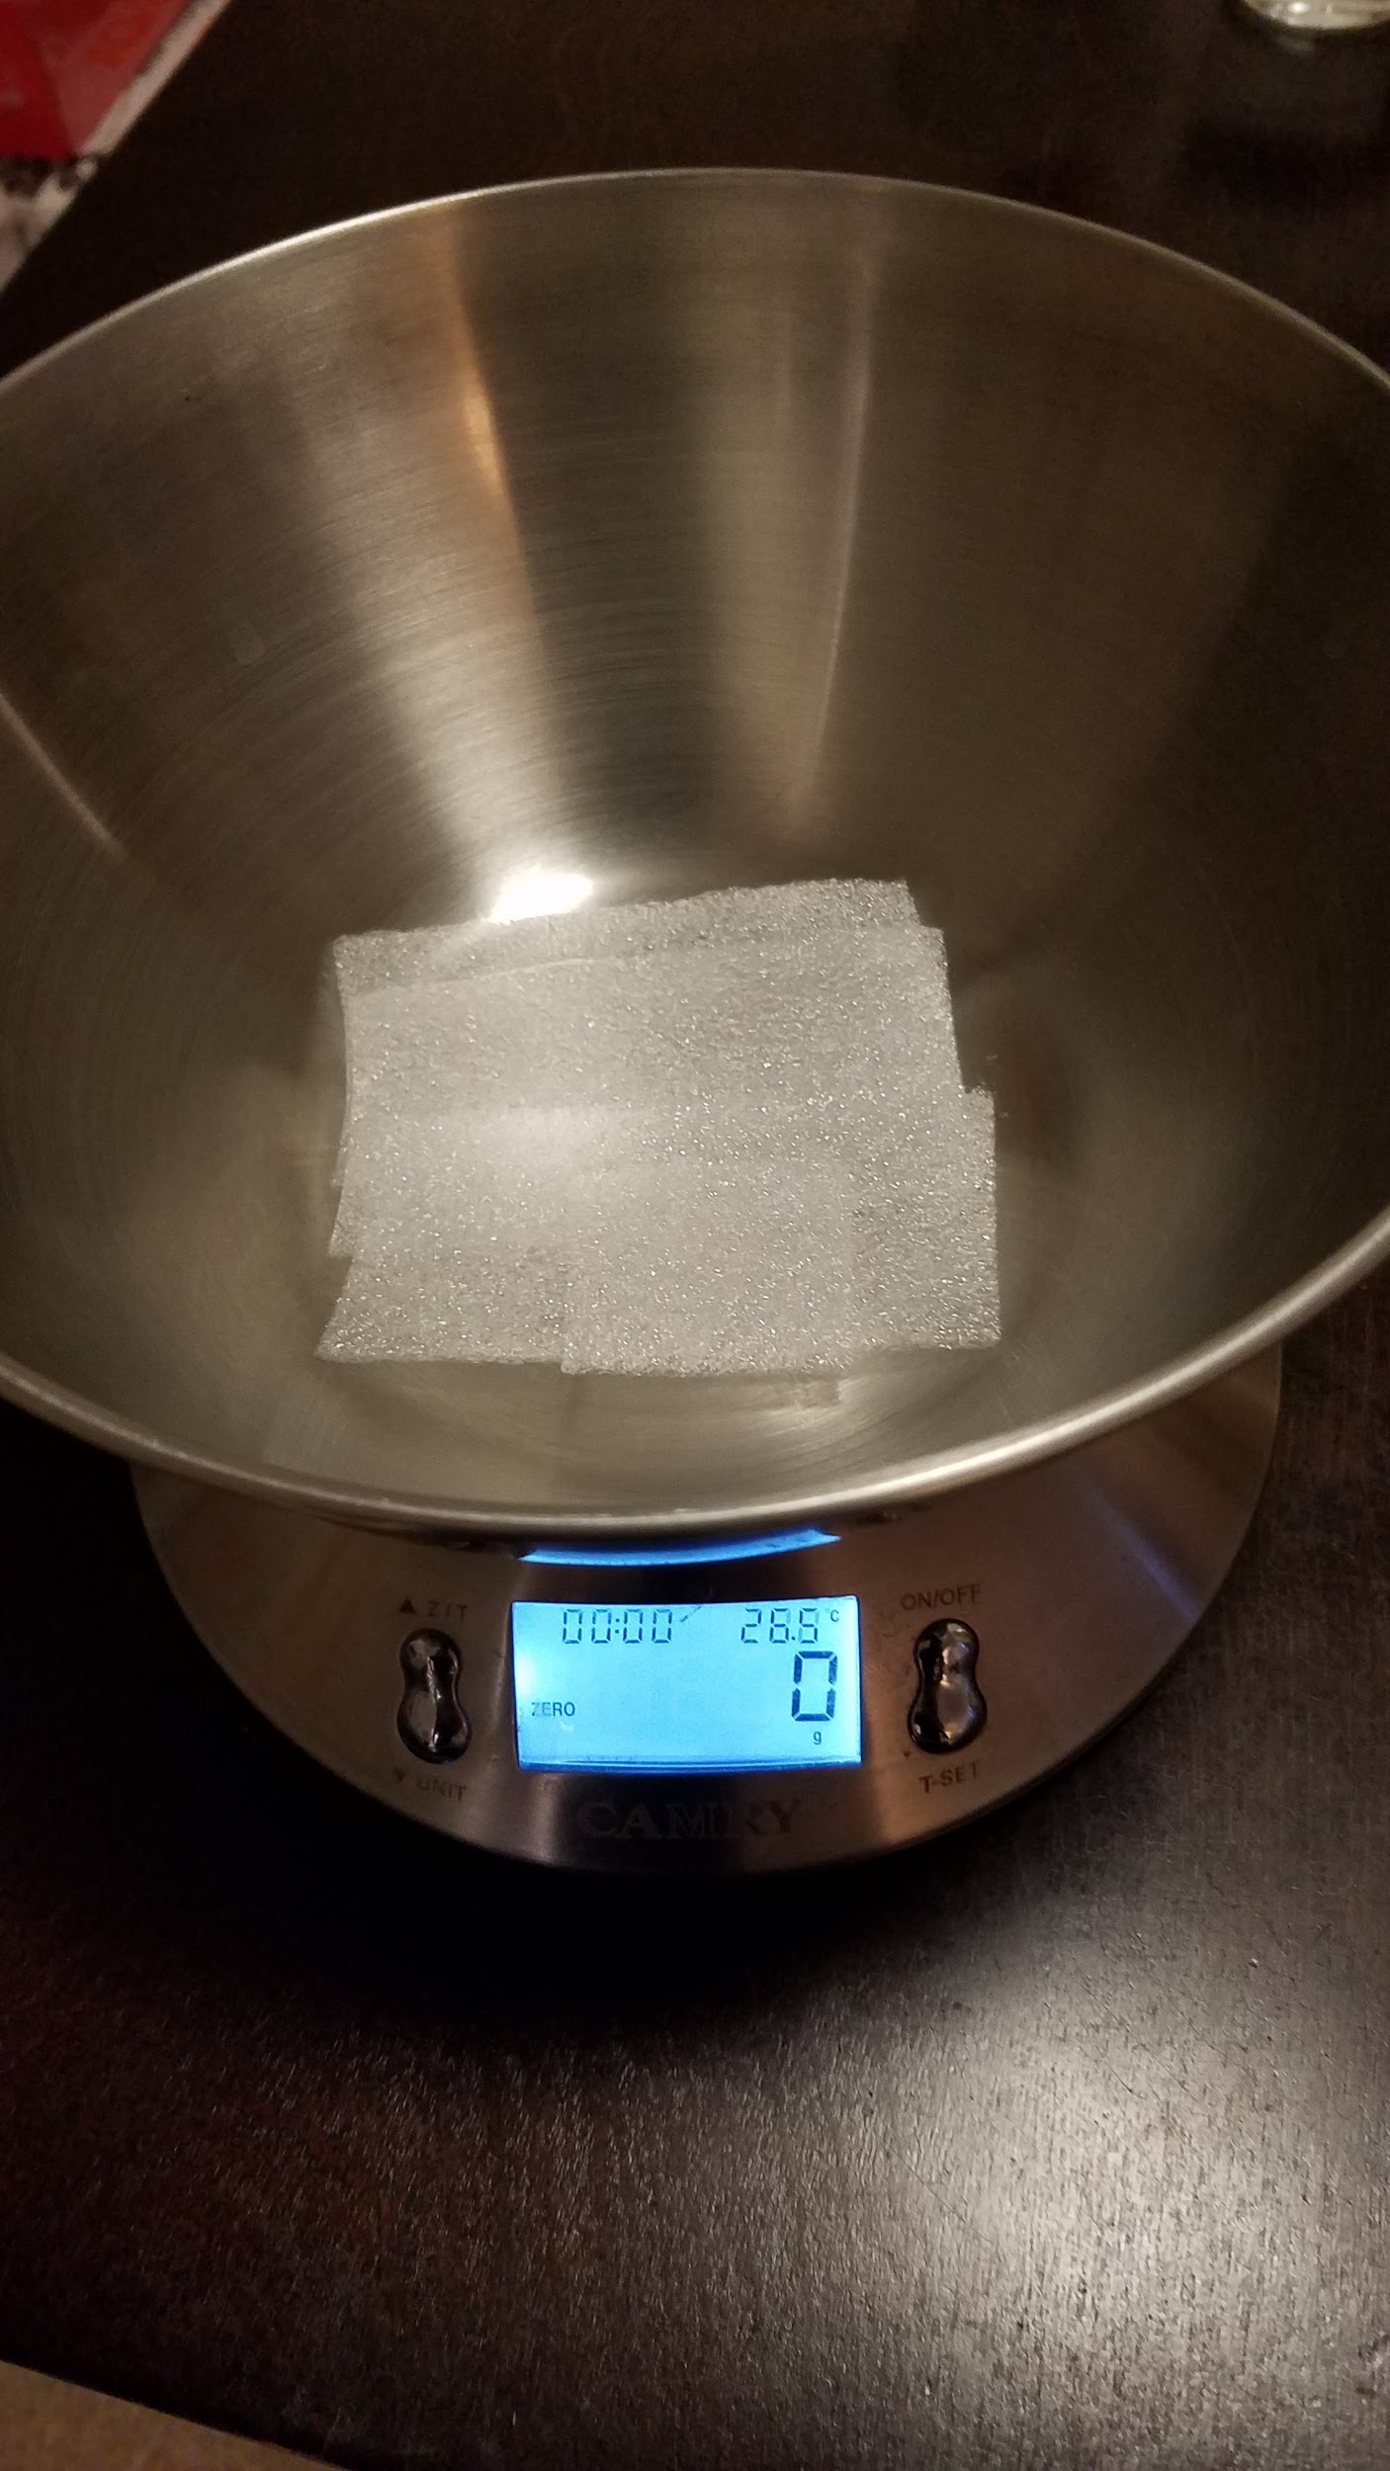
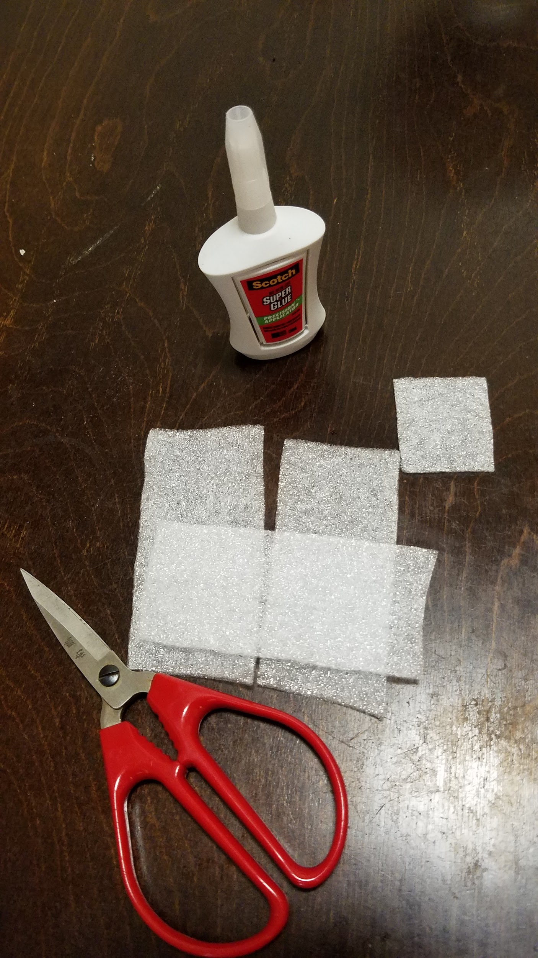
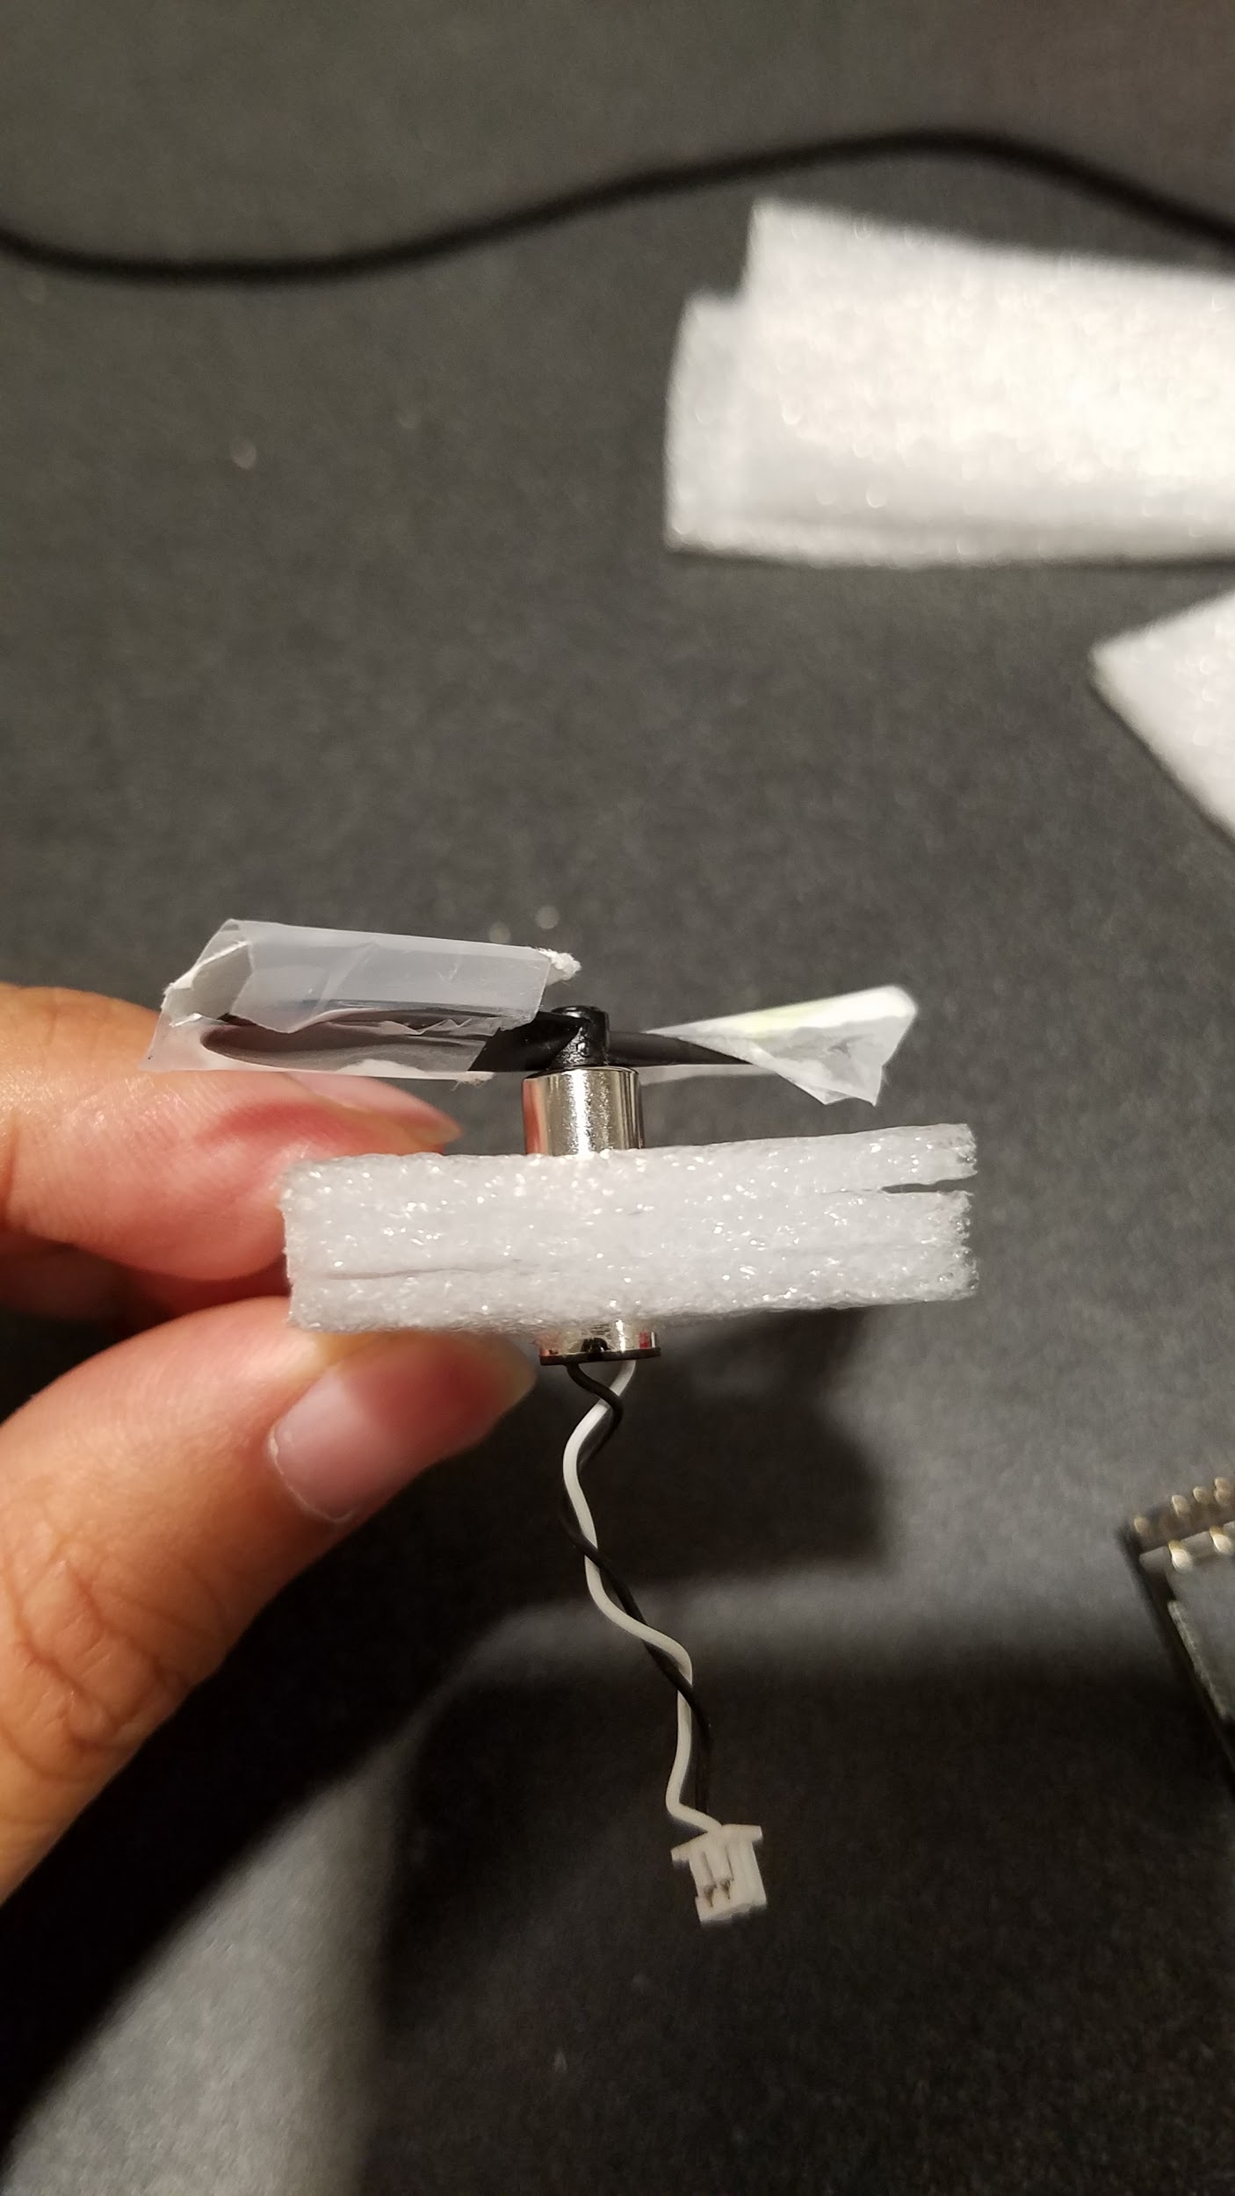
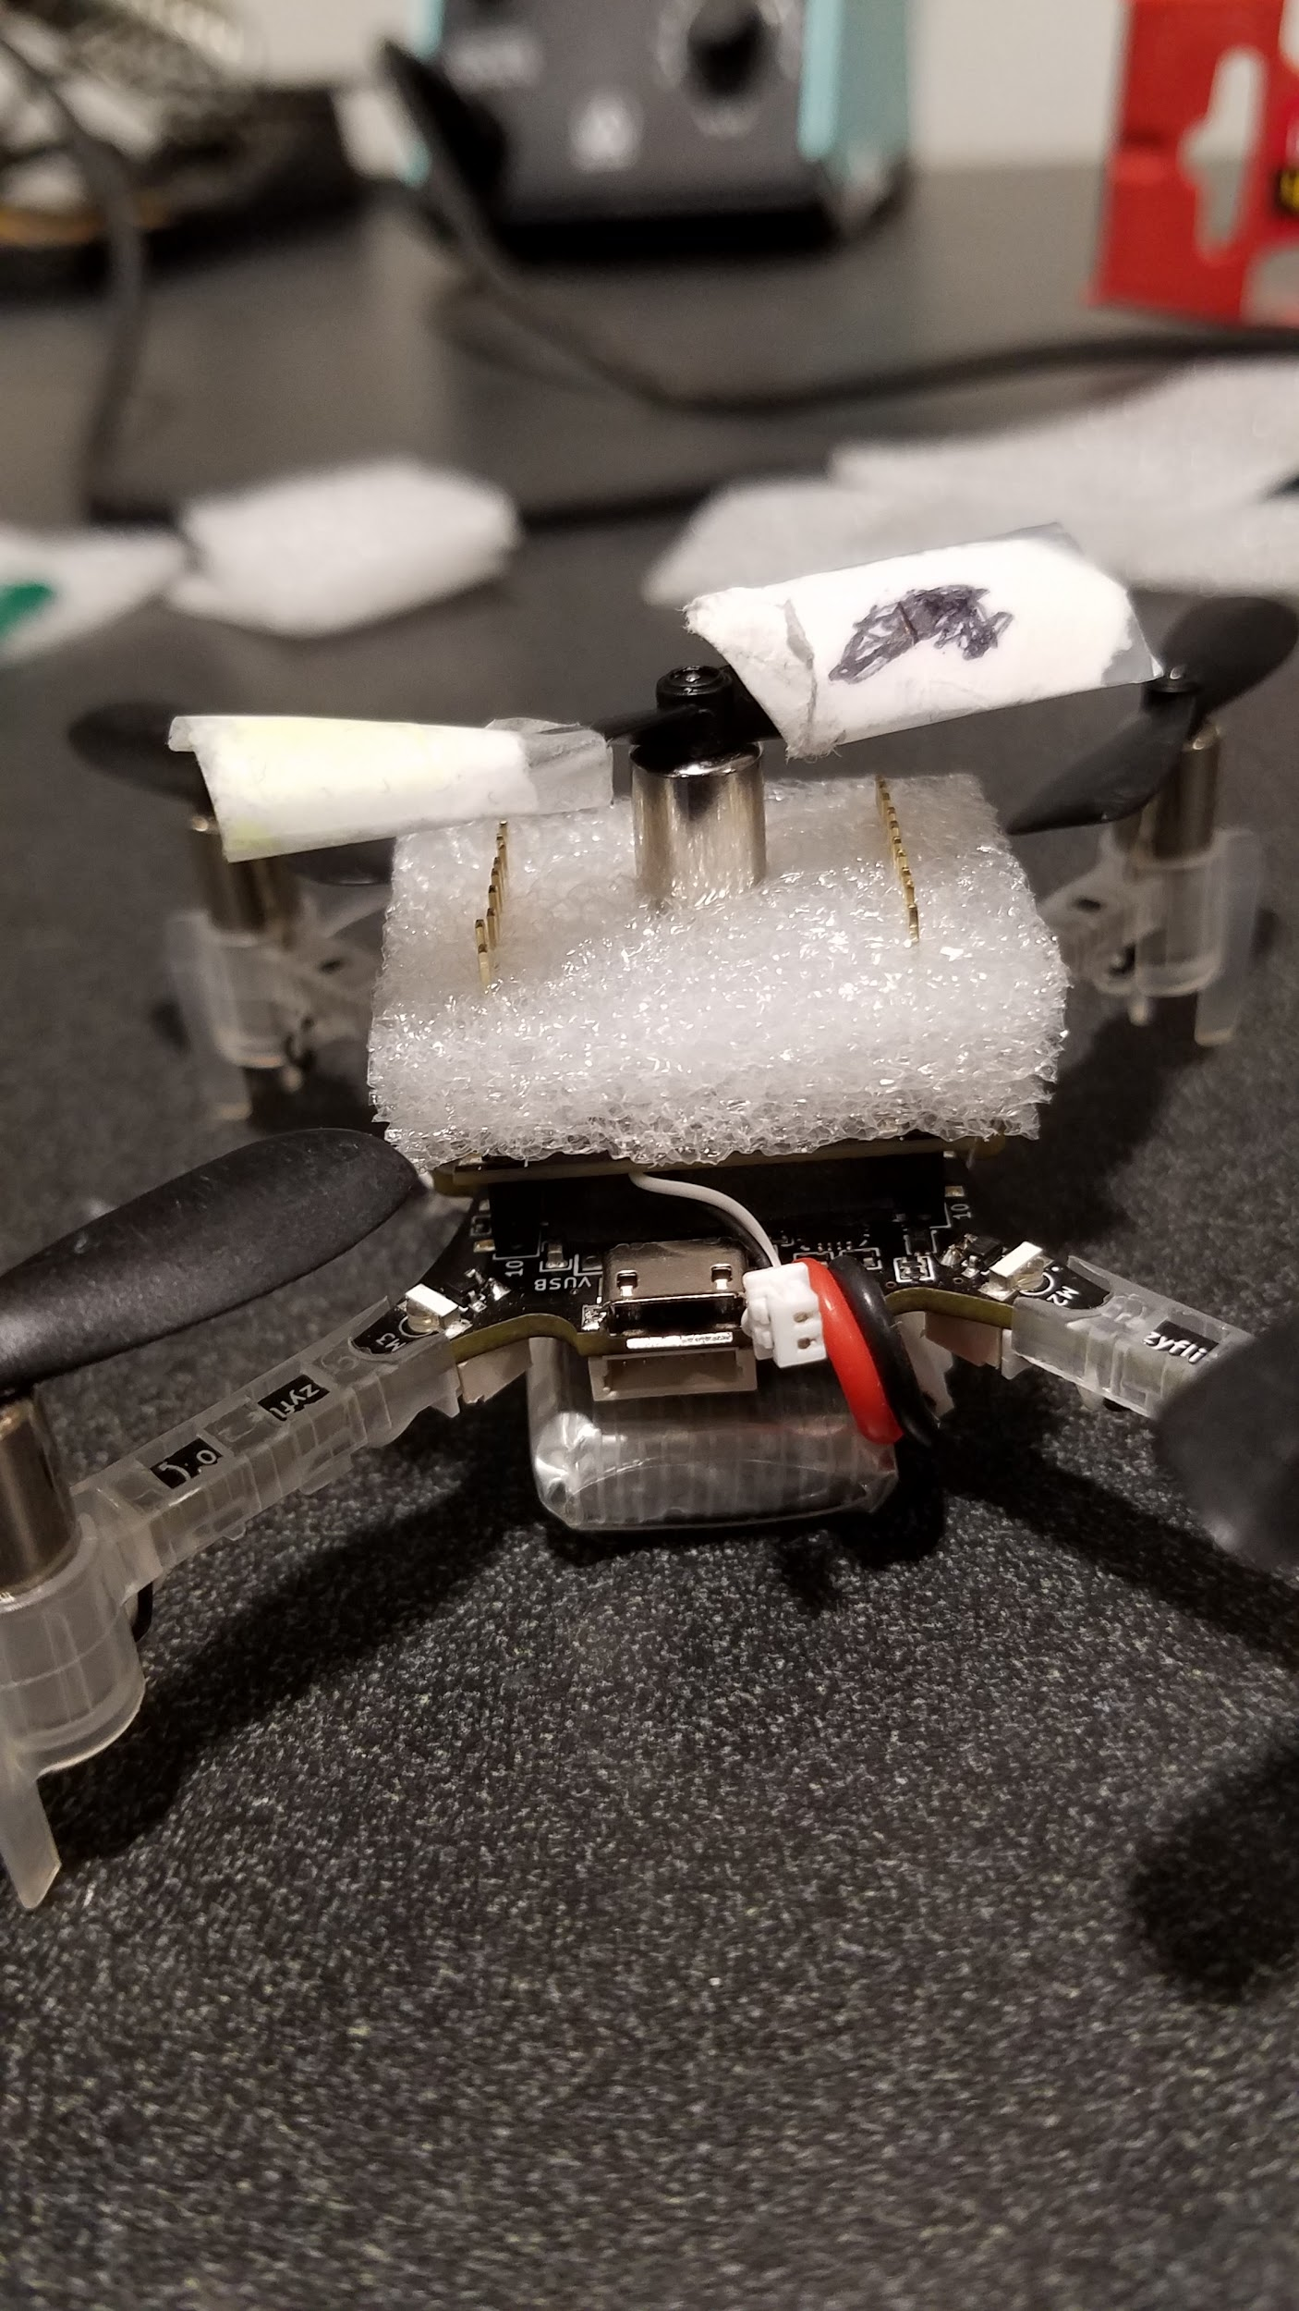
Connection Implementation
Light
Adjustable
Removable
Sturdy

Slide 4
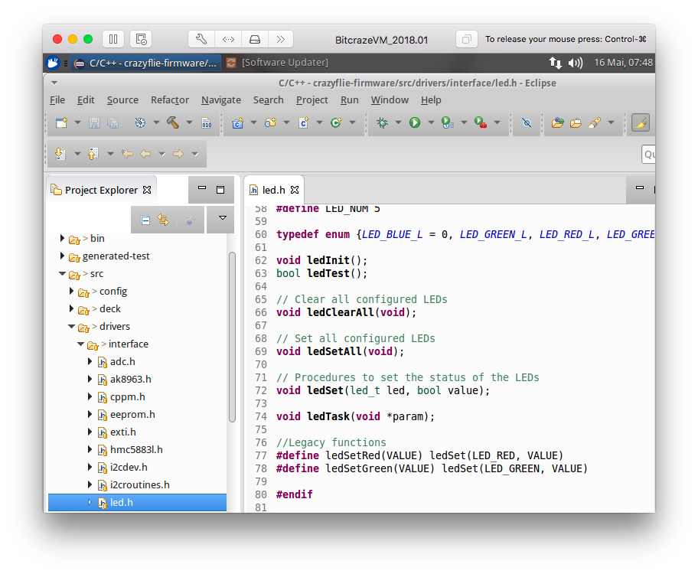
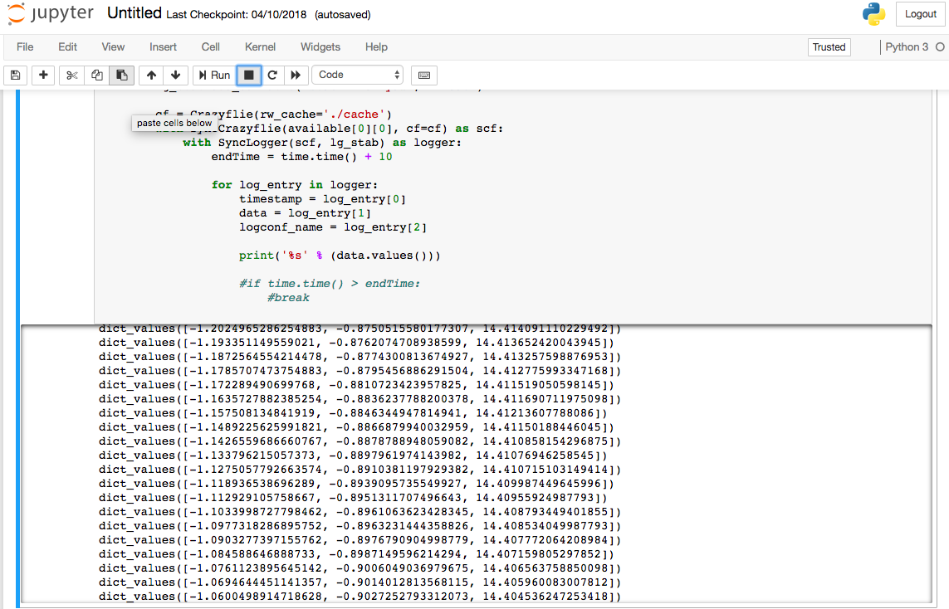
Sensor Fusion
Quadcopter Body State
Controller State

Slide 5
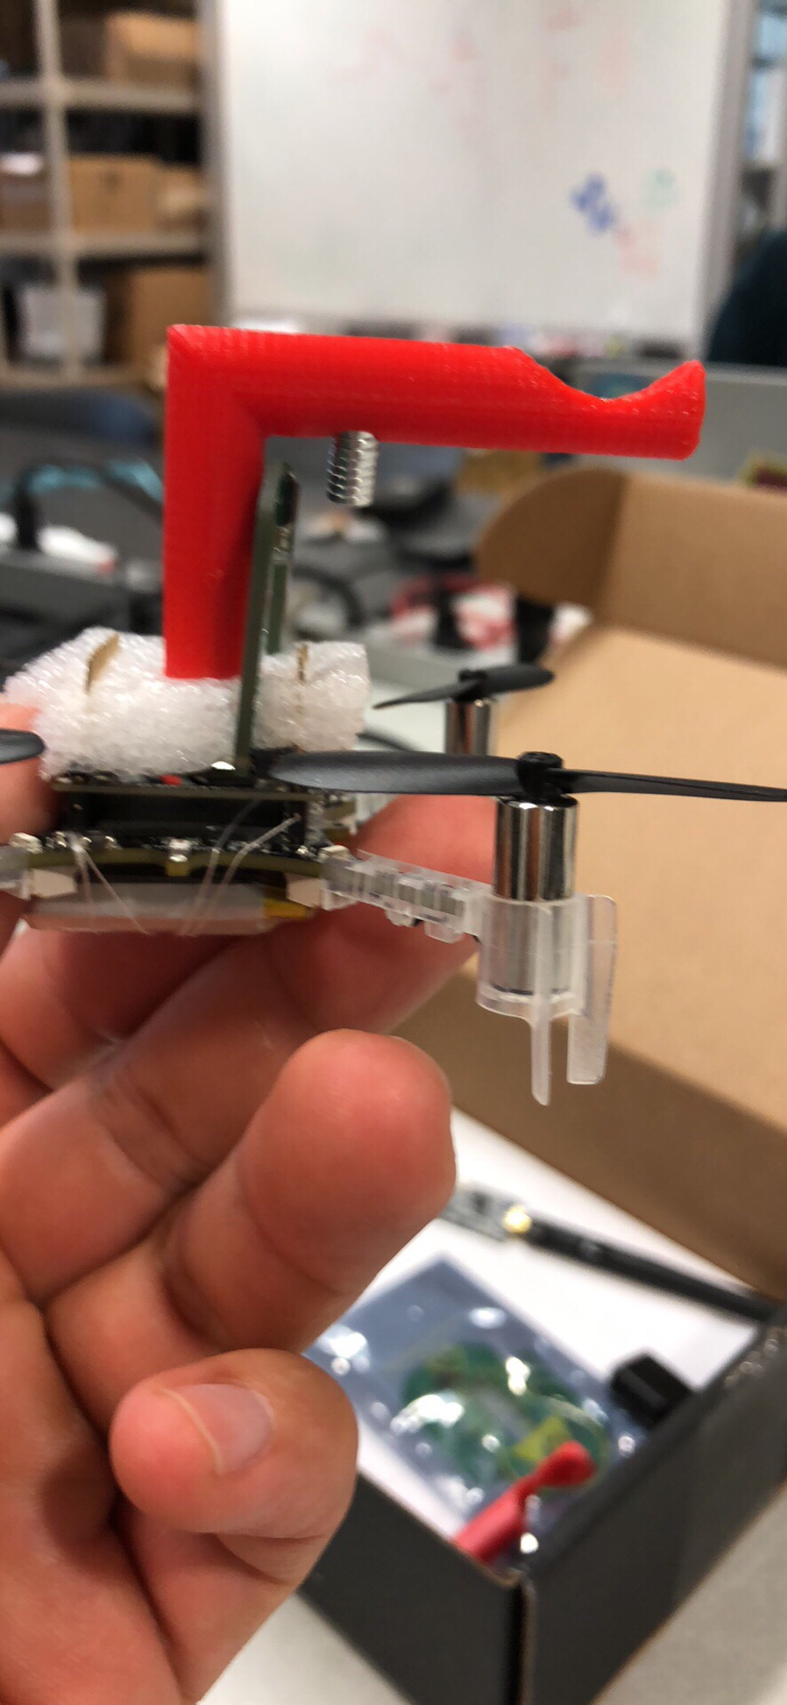
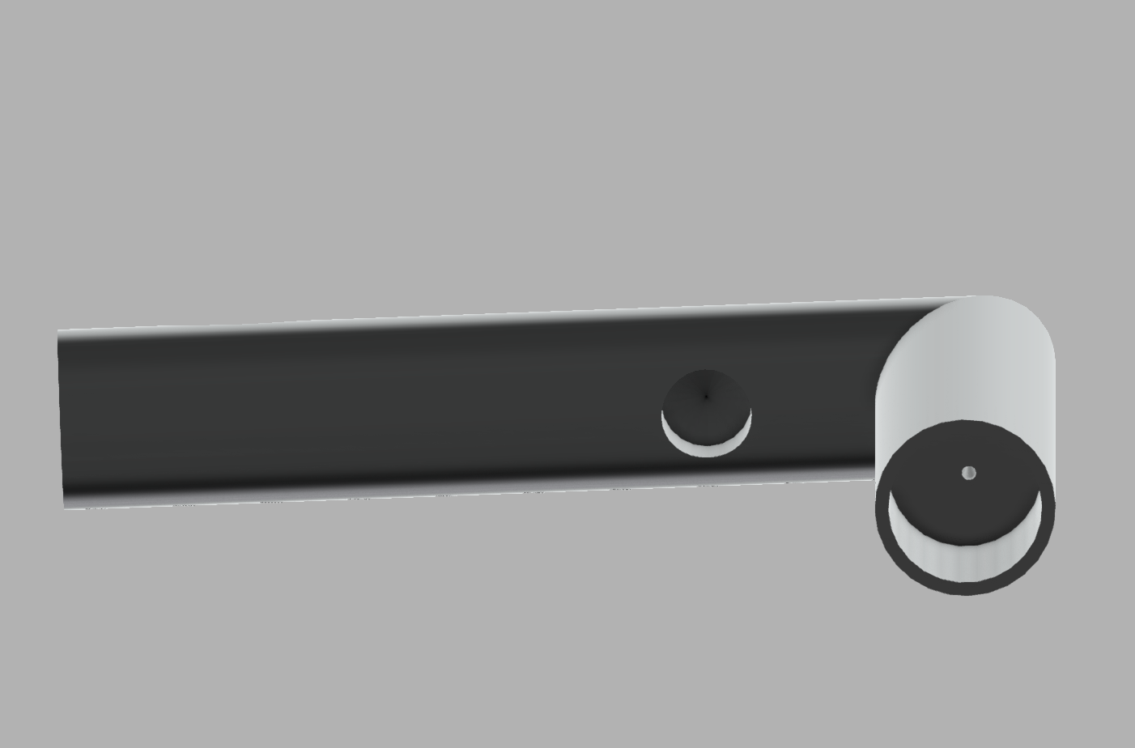
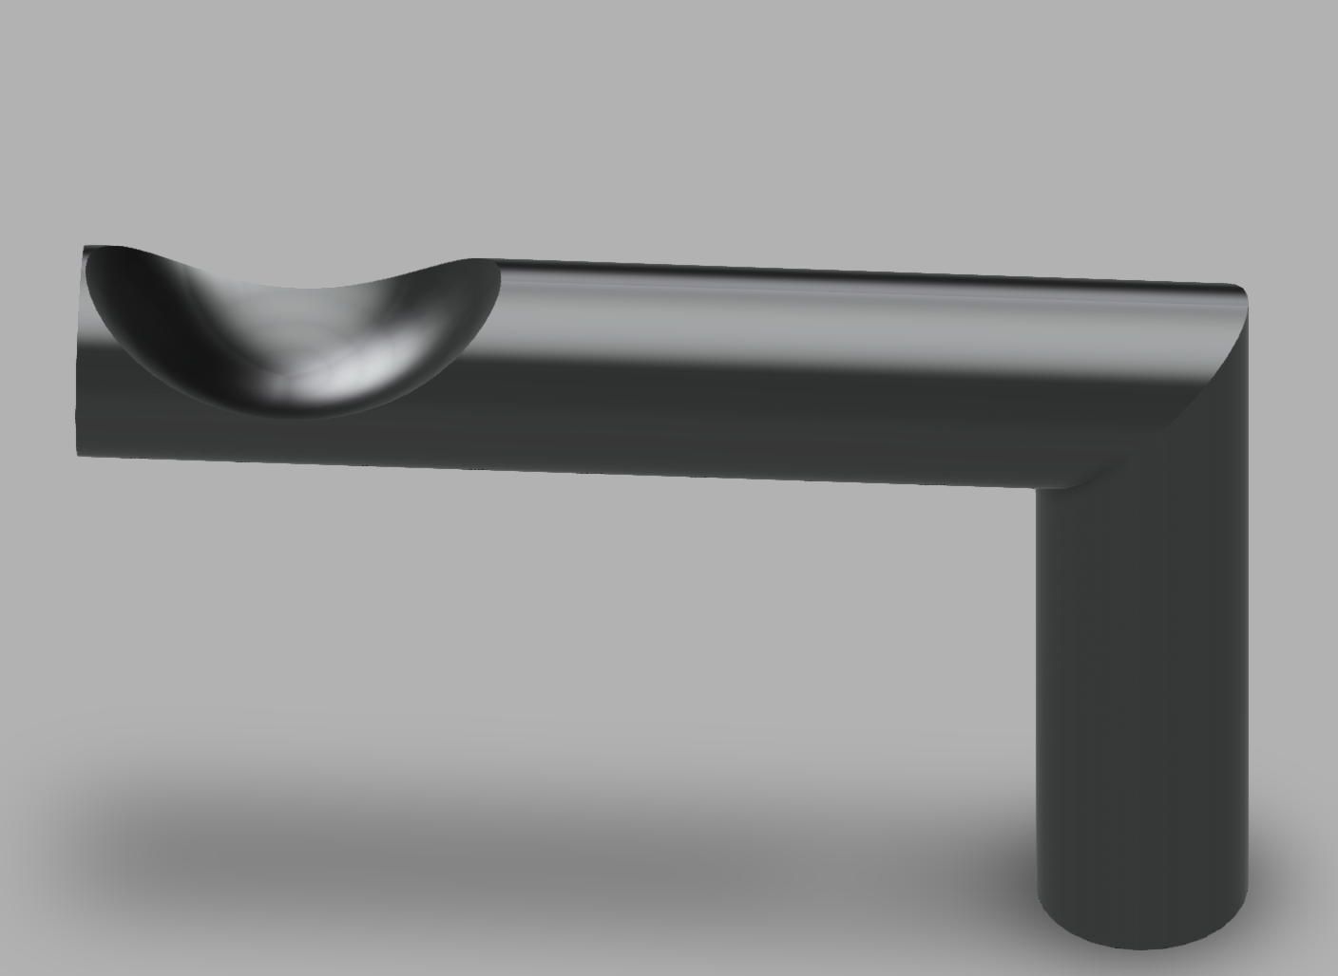
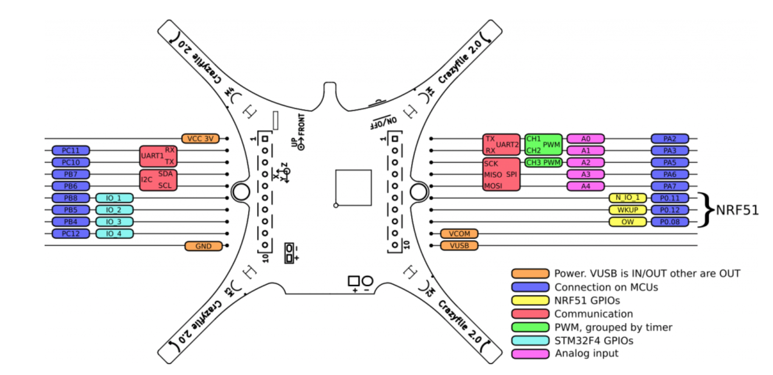
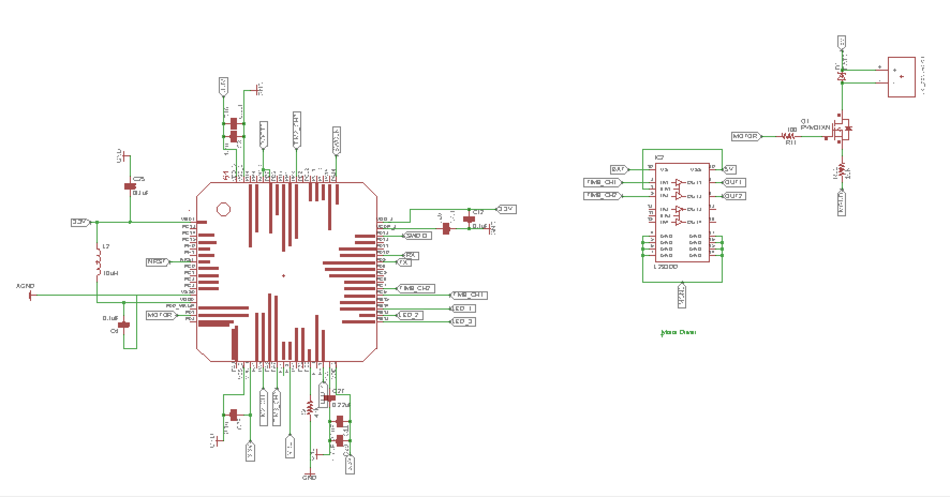
Controller model Schematics
And Modified spinning arm
Modified Prototype
Controller components
Crazyflie Component Placement
Motor Encoder
Demo Link : https://youtu.be/SJowaesDsbo

Slide 6
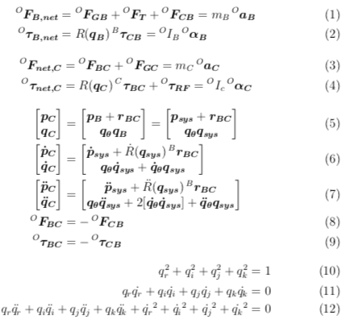
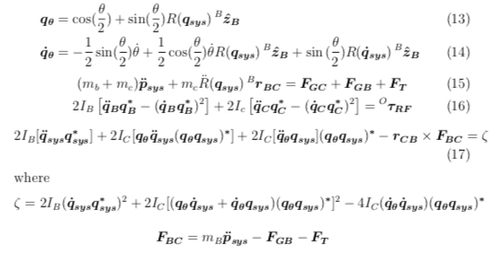
Documentation

Slide 7
Next Week Planning
Testing the model with drone+OCSM module attached
Finish the controller circuit
Documentation

Slide 8
References
https://www.bitcraze.io/2014/08/crazyflie-2-0-expansion-port/

